Slide 1
Technical Discussion Support System
By
Ankit Agrawal (Roll No: 05)
Atharv Dhoble (Roll No:26)
Sudeept Dubey(Roll No: 28)
Guide:- Mrs. Pranjali Kasture

Slide 2
Flow of Presentation
Introduction
Proposed Architecture
Implementation / Testing
Results and Discussion
Conclusion

Slide 3
Introduction
Technical Discussion Support System is a project developed on web technology domain which focuses on providing an online platform for users where an effective interaction and transfer of thoughts and ideas among the users would take place.
Some of the technologies like PHP, JavaScript , Bootstrap and database connectivity is being implemented in the project.
Expert thinking about the topic can be modelled and learned and useful information is shared among the users.

Slide 4
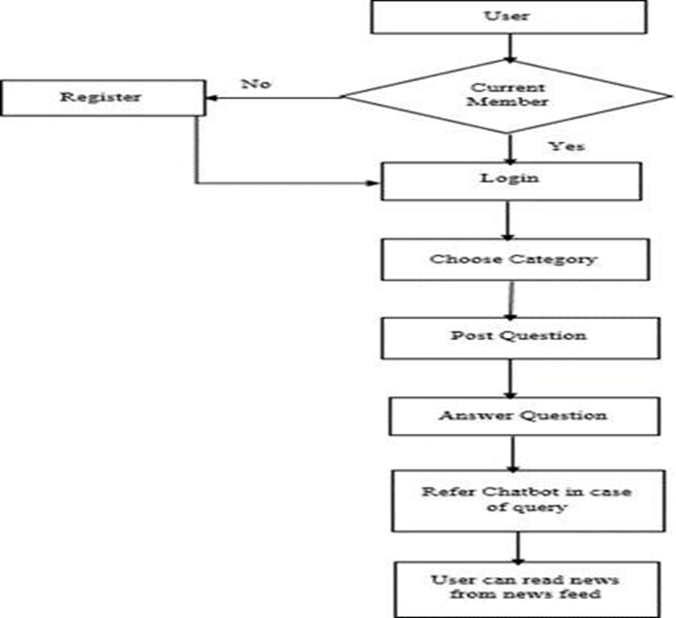
Proposed Architecture
Fig : Flow of System

Slide 5
Implementation/Testing
Some of the test cases have been identified while implementation of the project.
Test Cases:
User needs to register in the system before accessing the system.
After registering the user need to login to become the member of the system.
The discussions related to the questions will only be visible after admin approves the question.
Discussions will not be visible if admin rejects the question.

Slide 6
Result and Discussion
Technical Discussion Support System focuses on providing an e learning platform for the users for interaction purpose. The main motive behind this project is to establish a knowledge transfer among the people.
Firstly, the user needs to register in to the system to be the part of the forum. Once the user is registered a login page is generated which asks user to enter their email id and password for authentication purpose.
Once the user would become the member of the forum then he has a right to post questions and answer related to the topic of interest and thus an effective interaction would be established among the members of the forum.
News feed section is also provided through which the user would be aware of the daily happenings that are going all around in the world.
Chatbot mechanism is there. If a user is having certain doubts while using the technical discussion forum, he can get it cleared via chatbot mechanism which consists of predefined sets of questions along with the answers.

Slide 7
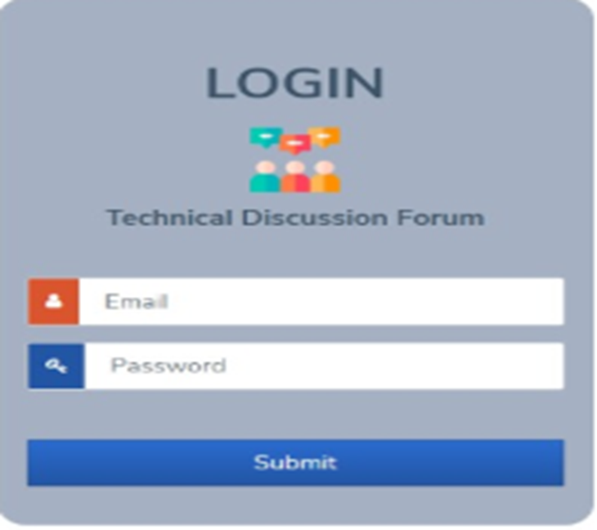
Result and Discussion (Screenshots)
Login Portal

Slide 8
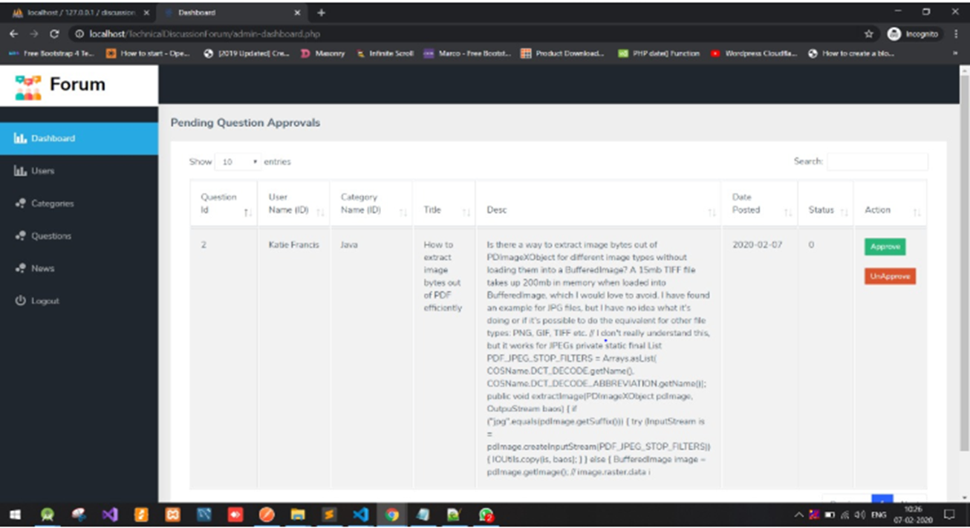
Result and Discussion (Screenshots)
Dashboard Portal

Slide 9
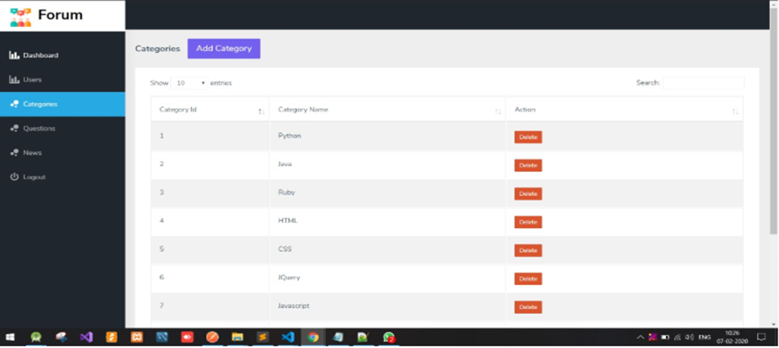
Result and Discussion (Screenshots)
Category Portal

Slide 10
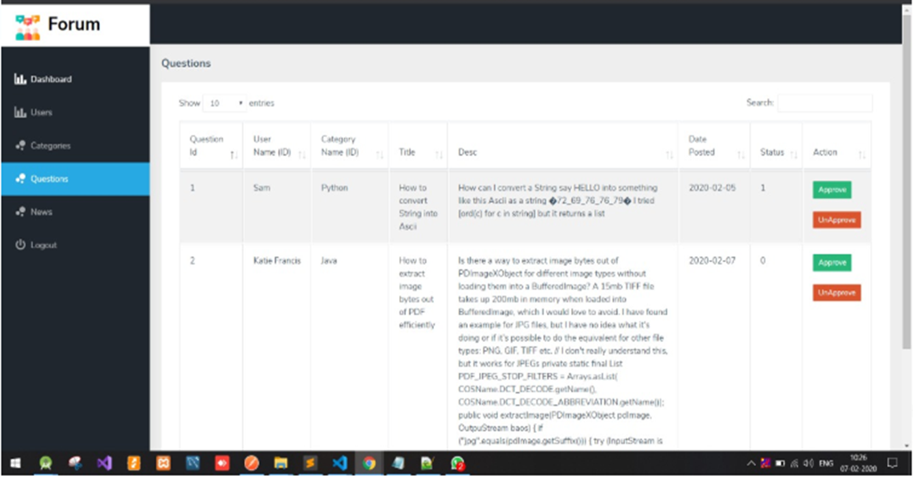
Result and Discussion (Screenshots)
Question Portal

Slide 11
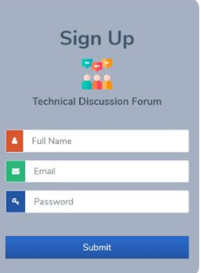
Result and Discussion (Screenshots)
SignUp Portal

Slide 12
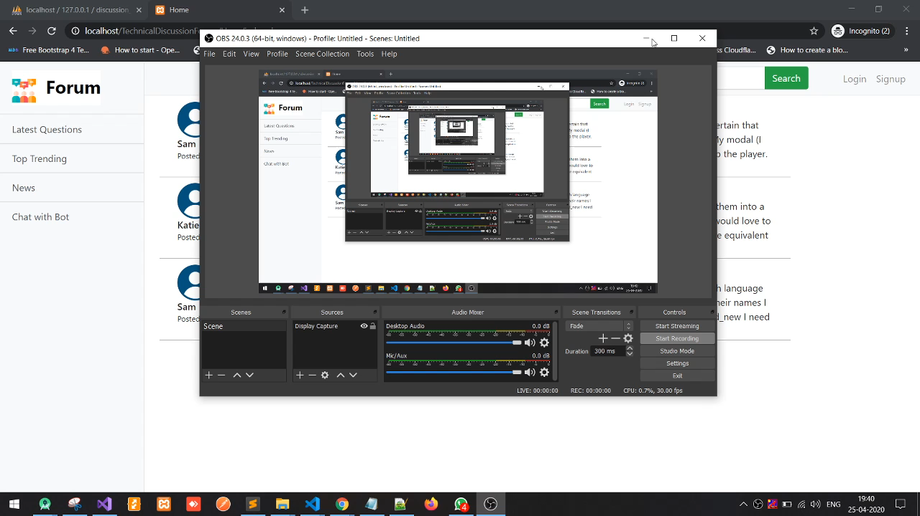
Video Summary

Slide 13
Conclusion
Technical Discussion Support System acts as an interactive tool and thus provide a wide platform for the users to explore the field of transfer of knowledge through which they would build interest in various topics and can discuss and communicate among themselves related to that particular topic.
News feed section is also provided through which the user would be aware of the daily happenings that are going all around in the world.
Chatbot mechanism is there. If a user is having certain doubts while using the technical discussion forum, he can get it cleared via chatbot mechanism which consists of predefined sets of questions along with the answers.

Slide 14
THANKYOU

